Slide 1
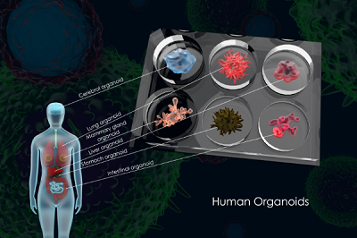
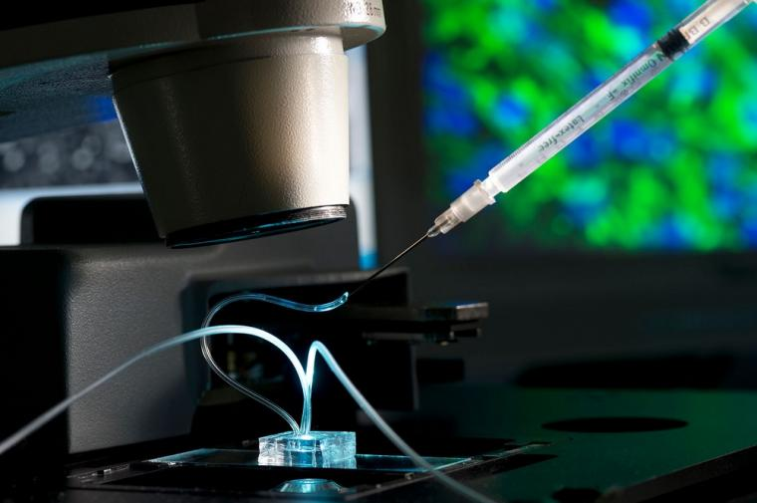
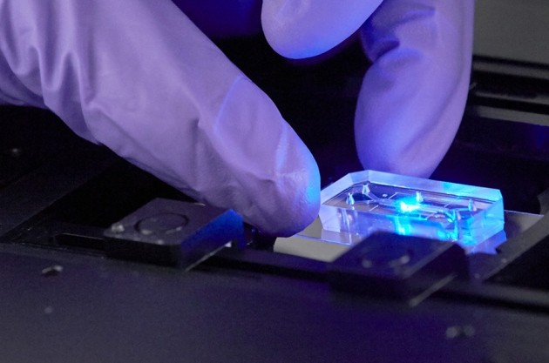
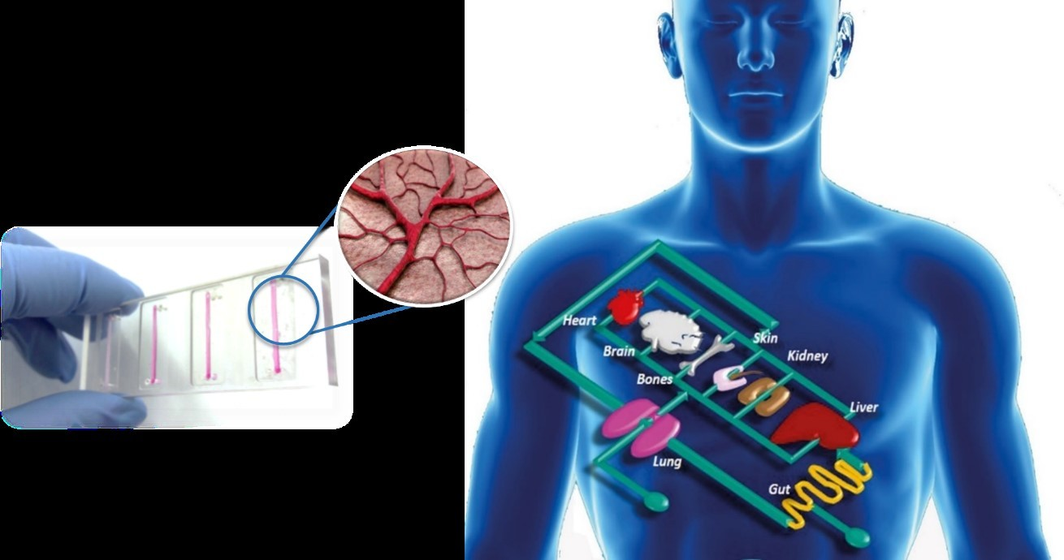
BENEFIS OF ORGANS ON CHIPS

Slide 2
Human model building facility.
Emerging organ on a chip technology Provides a new platform the study of radiological biology.
Mimicking the micro-environment of tissue and organs.
Technical microfluidic chips are meant to easy to use.

Slide 3
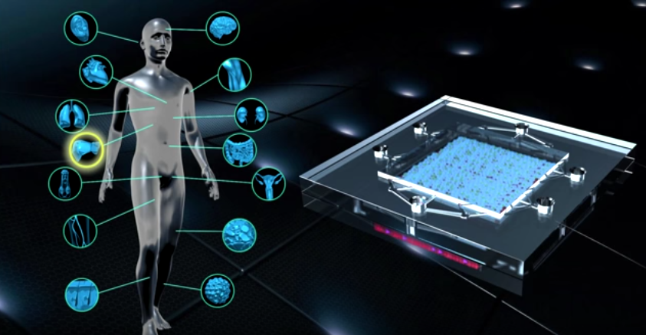
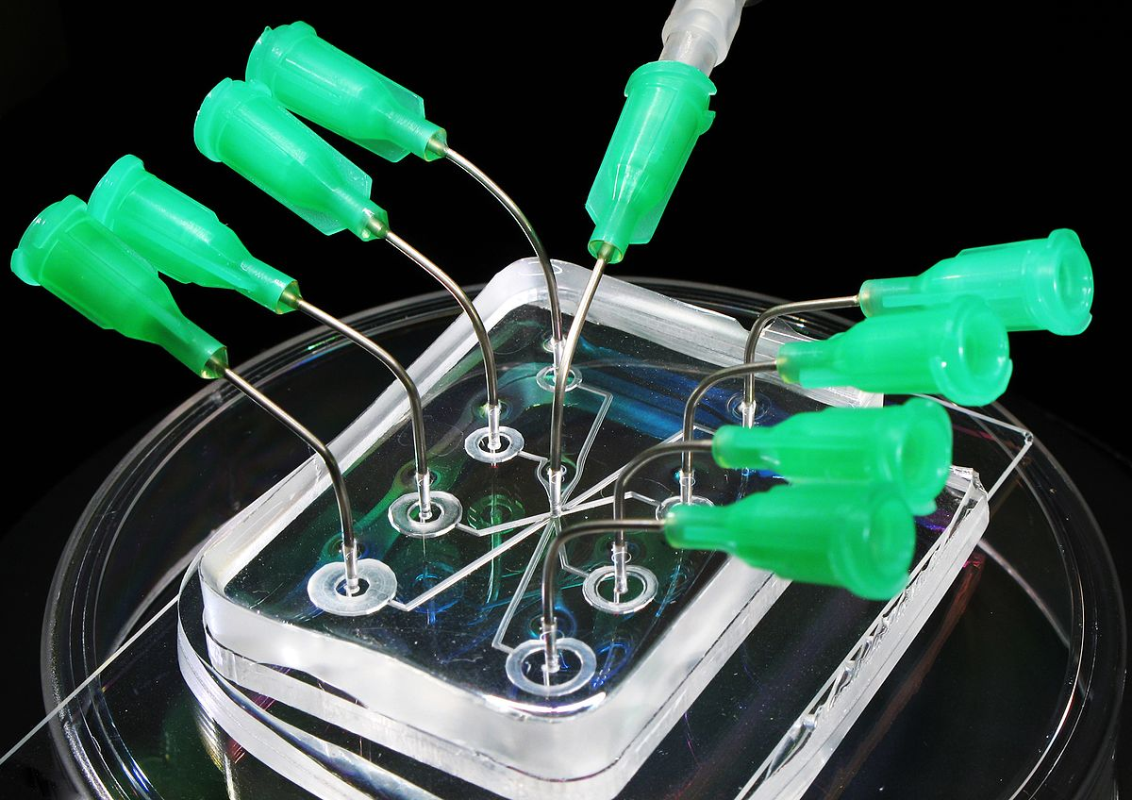
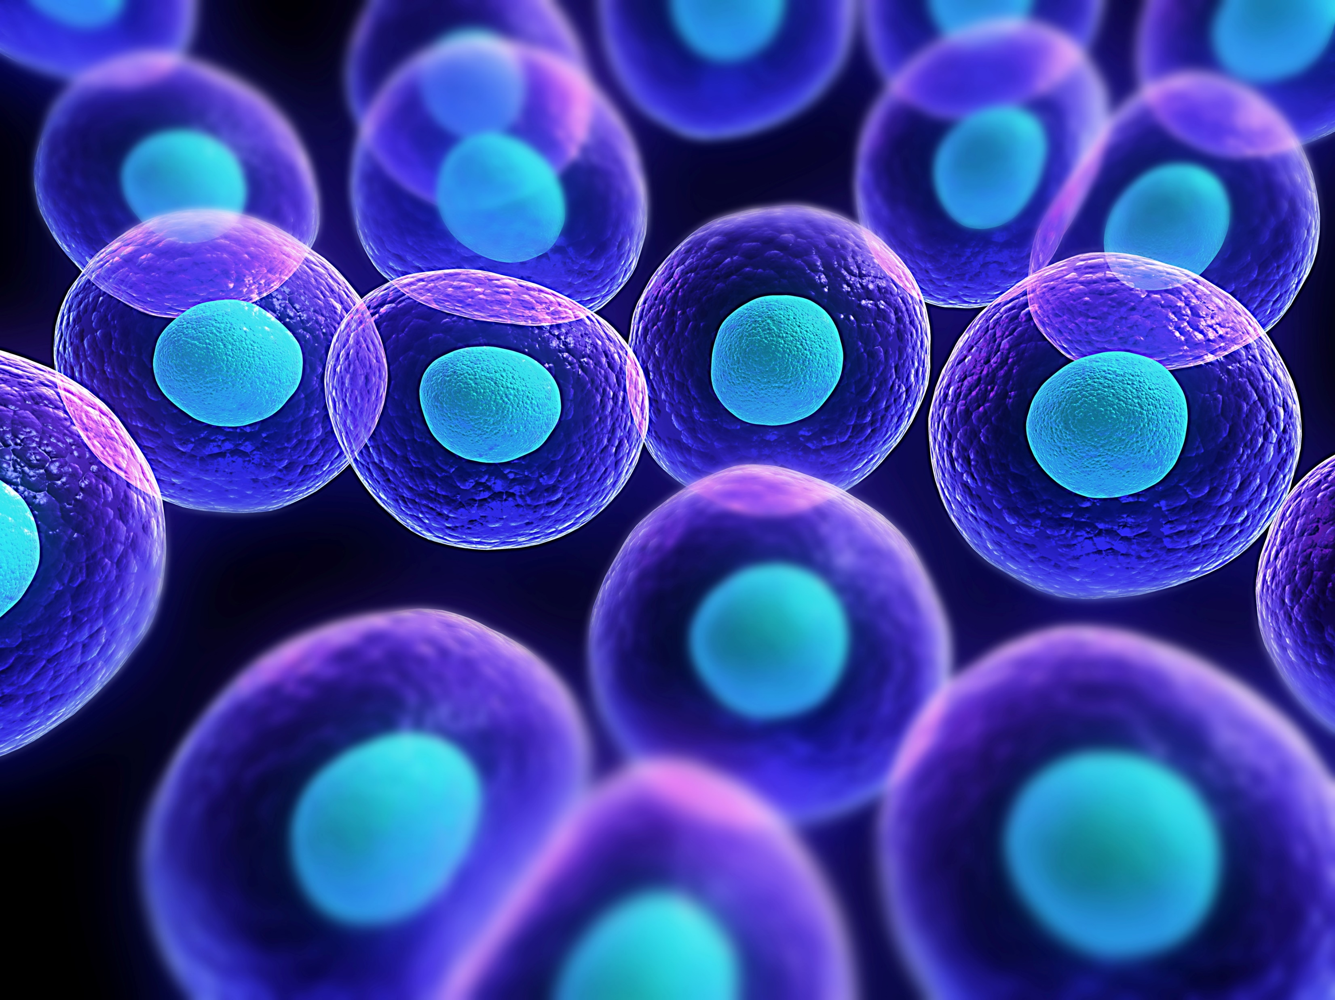
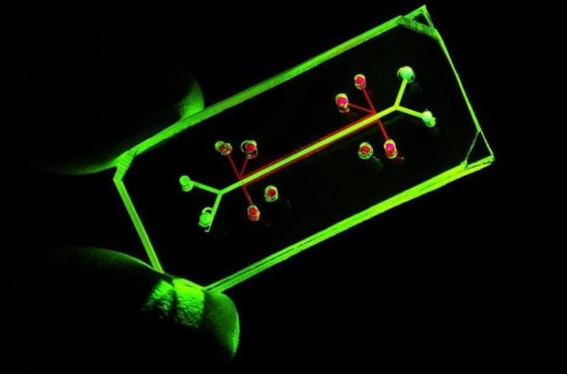
CHALLENGES OF ORGANS ON CHIPS

Slide 4
Obtaining representative human cells.
Very advanced technical knowledge was required.
Getting enough biological material for an accurate assay.
Advanced new technological equipment is required.

